Slide 1


Hackathon by Texas Instruments
Pizza Boy for medical uses
Team:
Robin Kremer
Sören Engelmann
Lennart Heib
Rosario Gandolfo

Slide 2

Demo Video
https://www.youtube.com/watch?v=1a3sVjHn6TE

Slide 3

Application

Slide 4
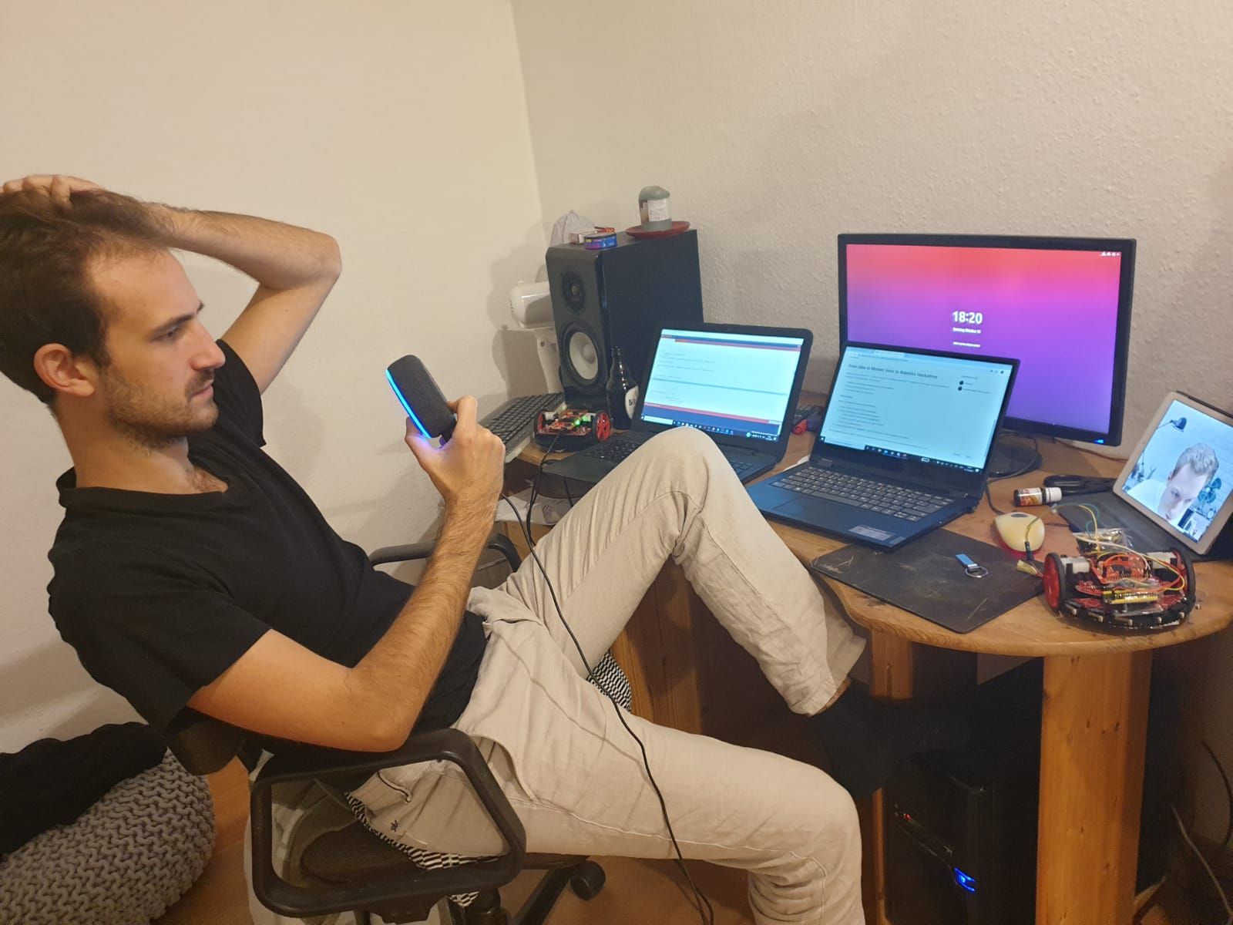
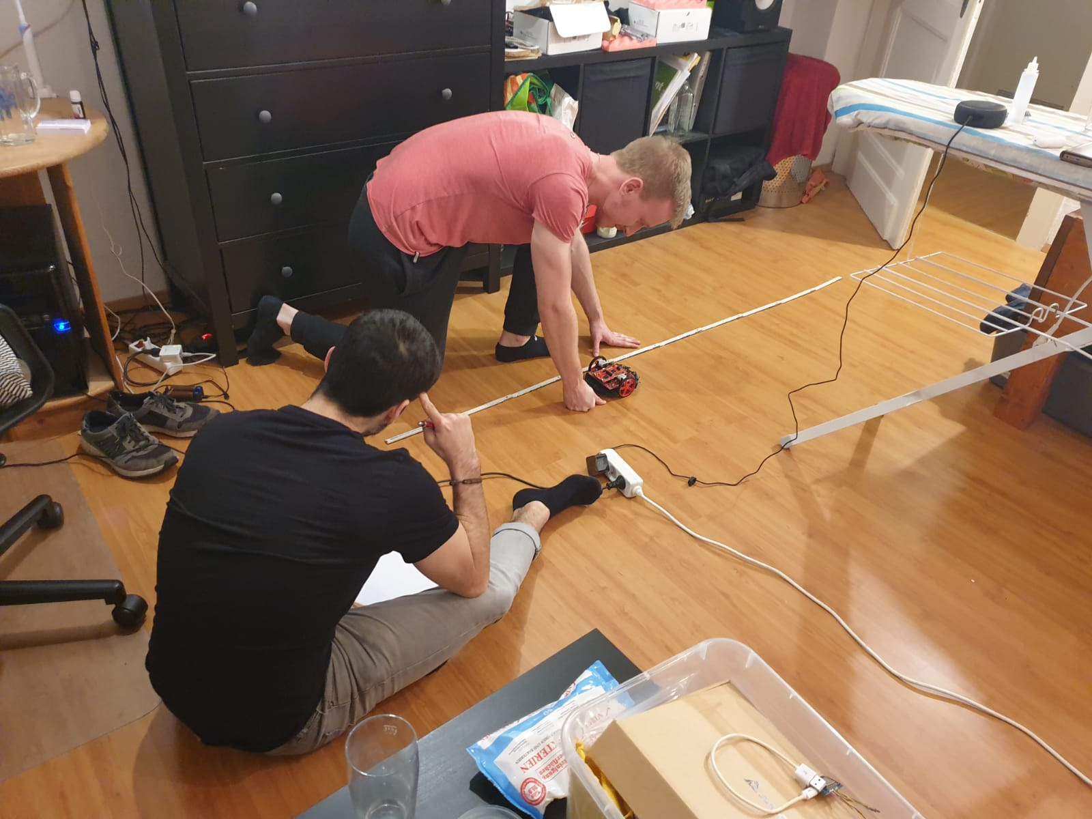
Build and Challenges

Slide 5
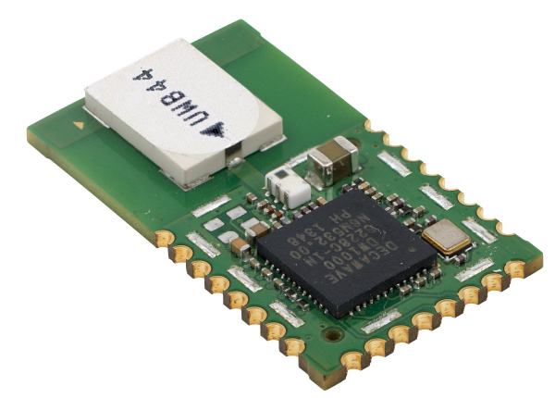
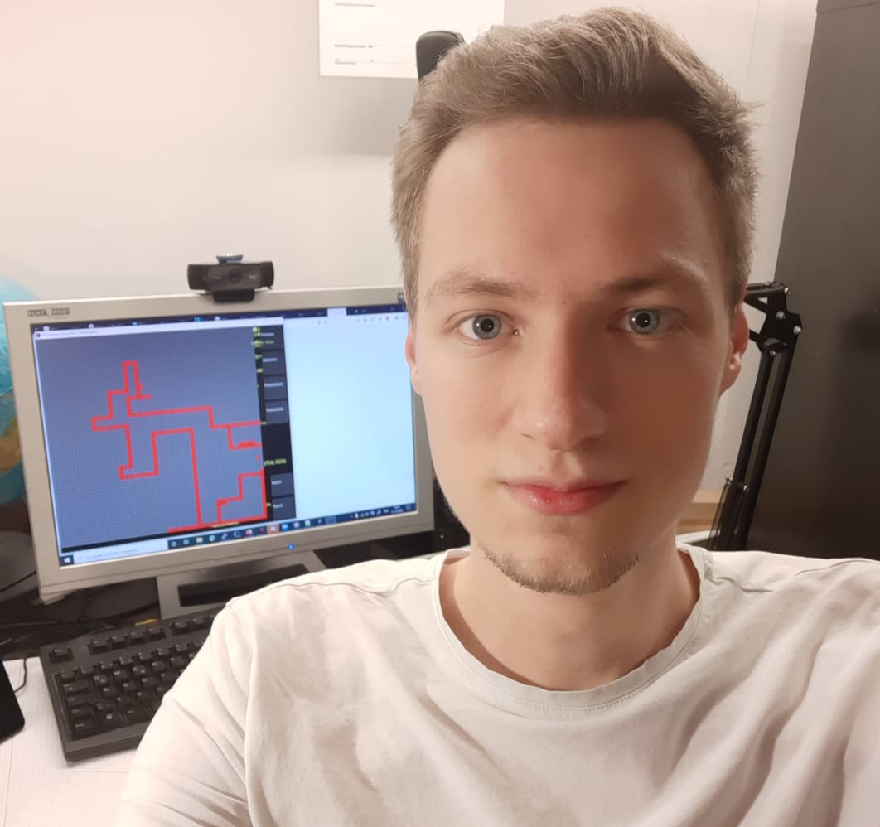
Further Possibilities

